Slide 1
Infosys Springboard Internship Project Food – Ordering - System
Our Project Mentor : Vamsi Mitra
By...
P. Sai Meghana | Suma | Tejaswini reddy | Hemanth pandey

Slide 2

Introduction
Project Title: Online Food Ordering System
Technologies Used: Django, SQLite3
Overview: A multi-role platform for customers, restaurants, and delivery personnel with custom navigation and functionality.

Slide 3
Modules used
Django Framework
Apps : accounts, restaurant, delivery, customer
SQLite3 Database
Pillow : Used for image processing in Django projects
How to install : pip install <module_name>

Slide 4
Usage of files in django project
manage.py: Entry point for running the server, migrations, and project setup.
settings.py: Configuration settings for the project.
urls.py: URL routing for different views.
models.py: Database models definition.
views.py: Handles logic for each view.
templates/: HTML files for each app's pages.

Slide 5
Website urls & images

Slide 6
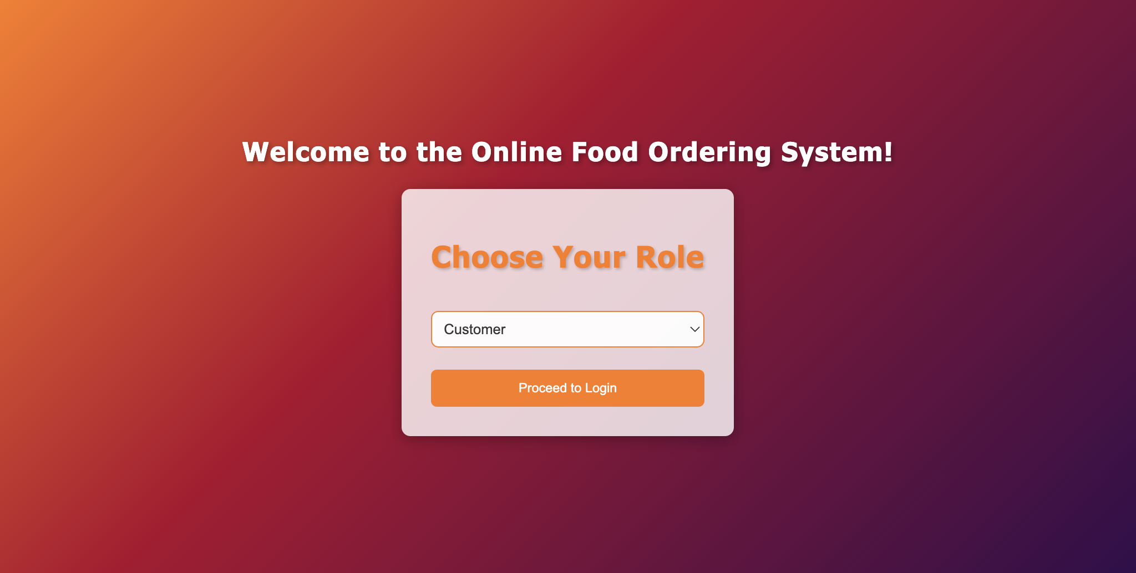
http://127.0.0.1:8000/

Slide 7
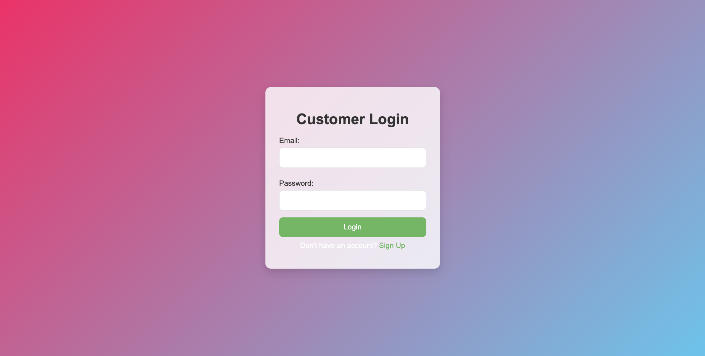
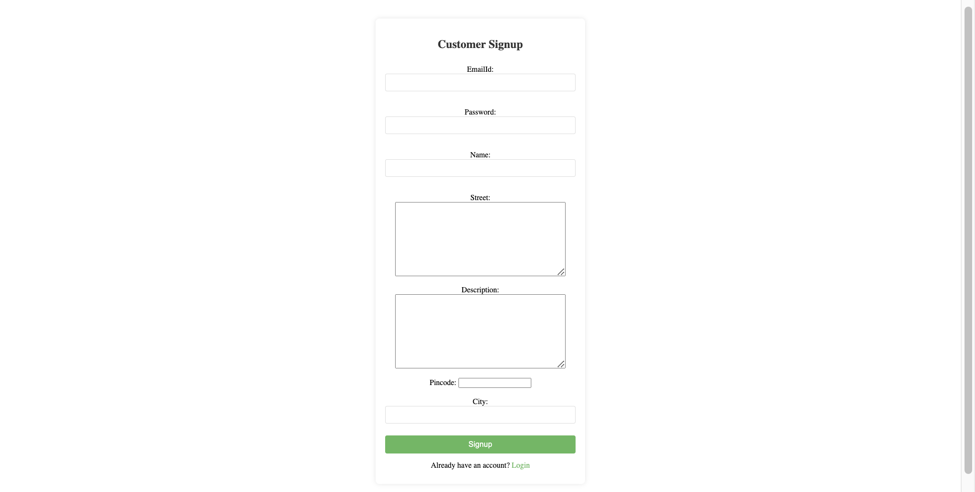
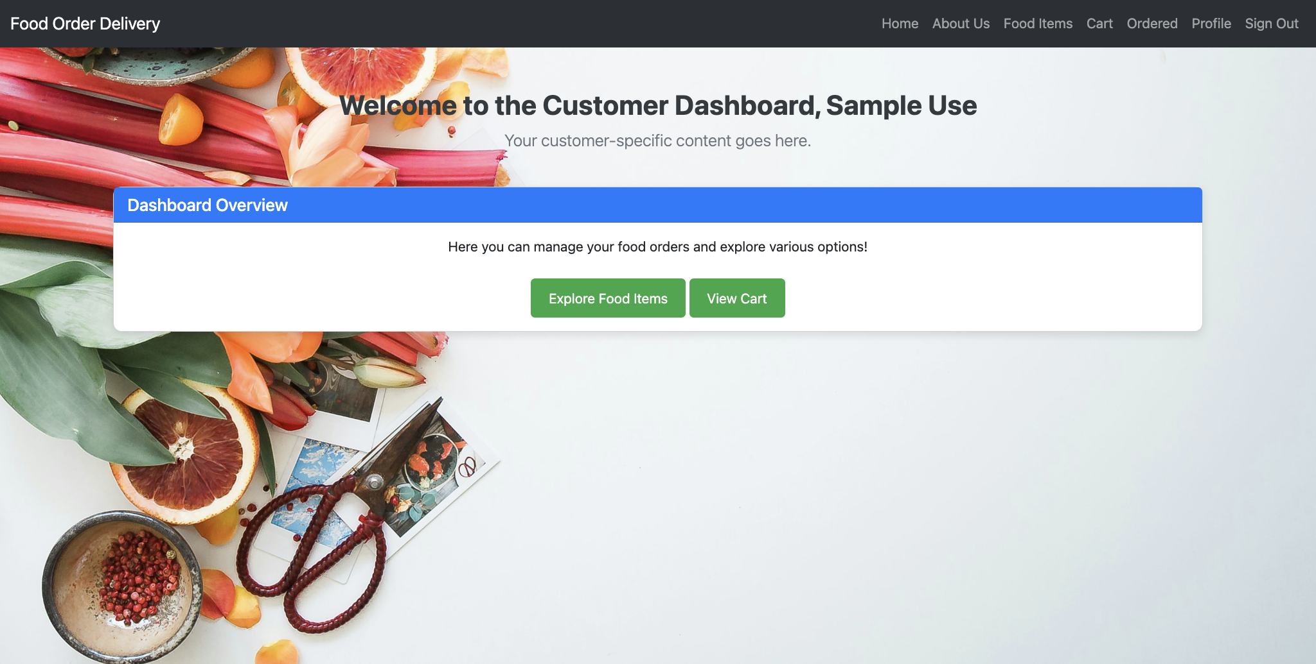
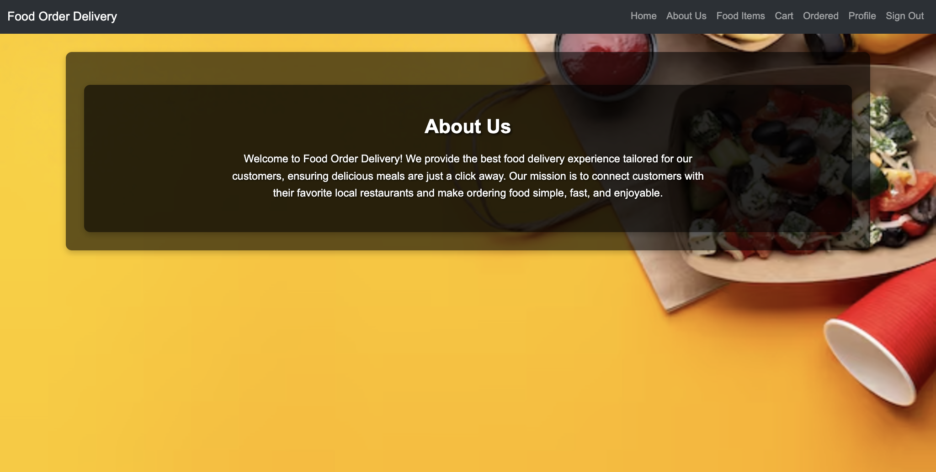
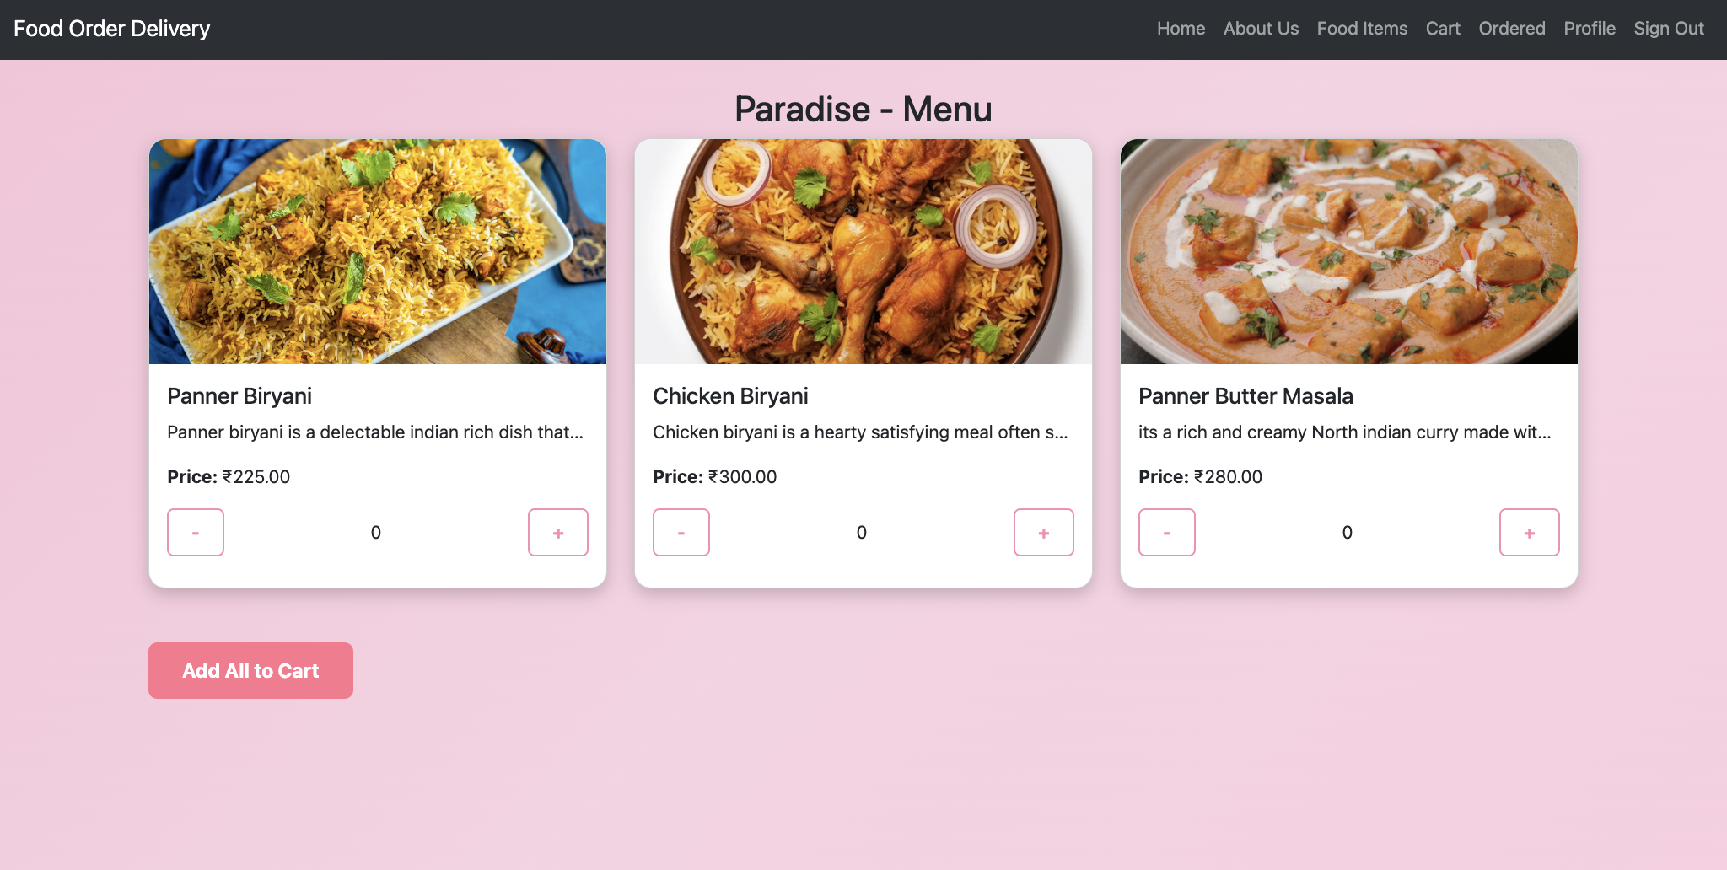
http://127.0.0.1:8000/customer/signup/
http://127.0.0.1:8000/customer/login/
http://127.0.0.1:8000/customer/home/
http://127.0.0.1:8000/customer/about/
http://127.0.0.1:8000/customer/food_items/
http://127.0.0.1:8000/customer/restaurant/<uuid:restaurant_id>/menu/
http://127.0.0.1:8000/customer/add-to-cart/
http://127.0.0.1:8000/customer/cart/
http://127.0.0.1:8000/customer/profile/
http://127.0.0.1:8000/customer/profile/edit/

Slide 8
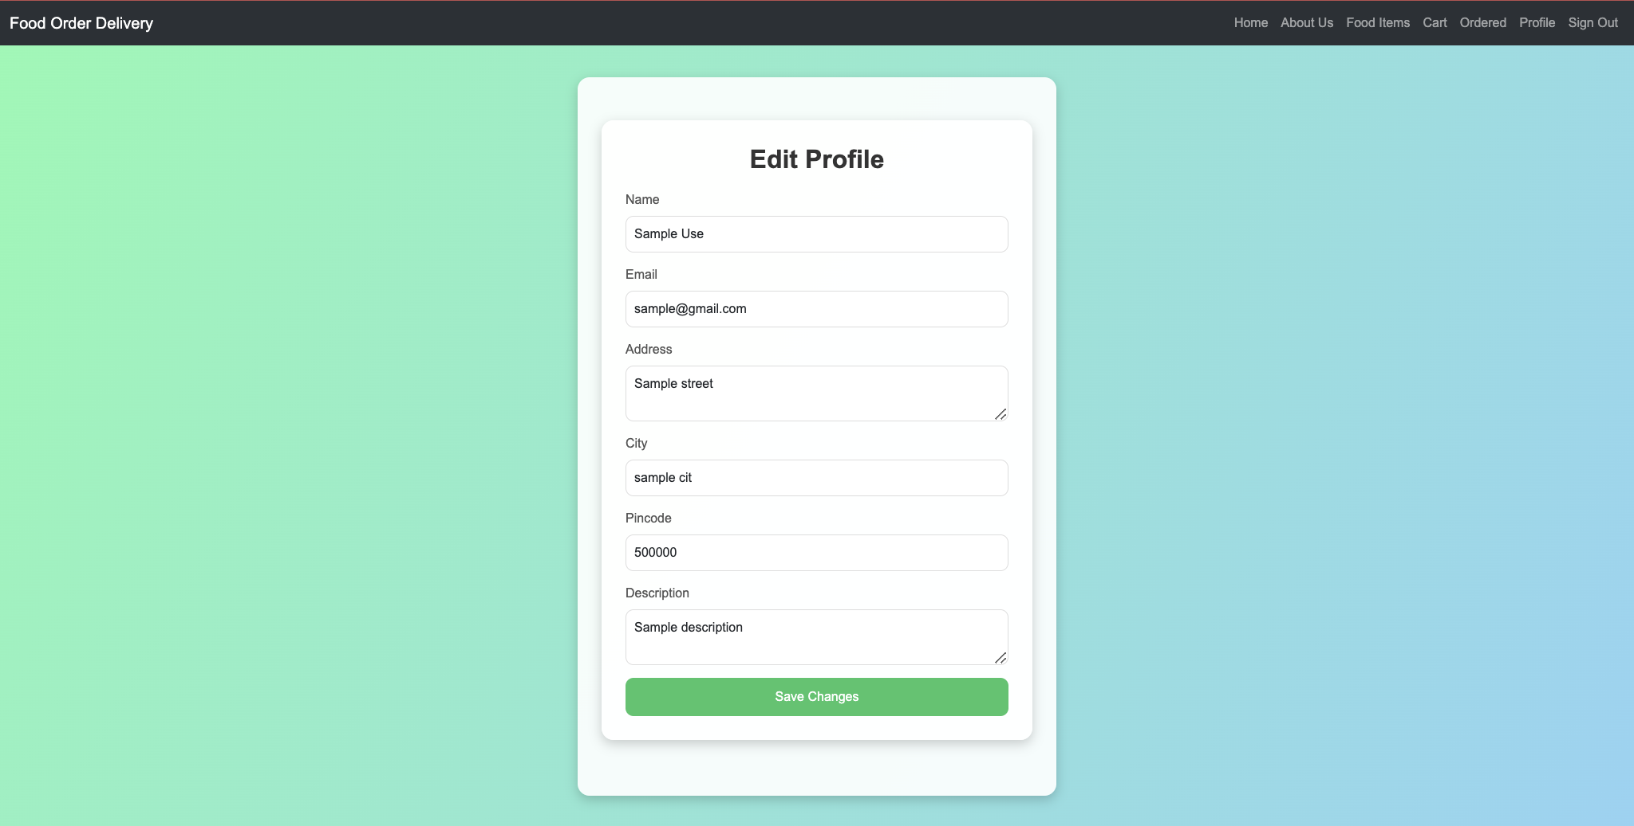
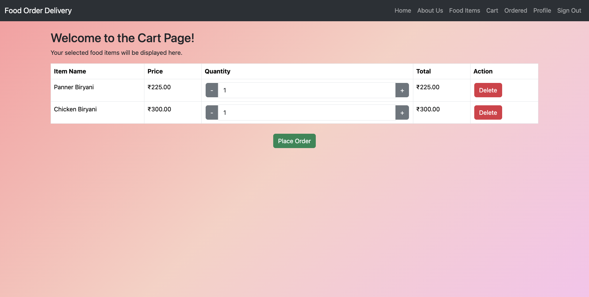
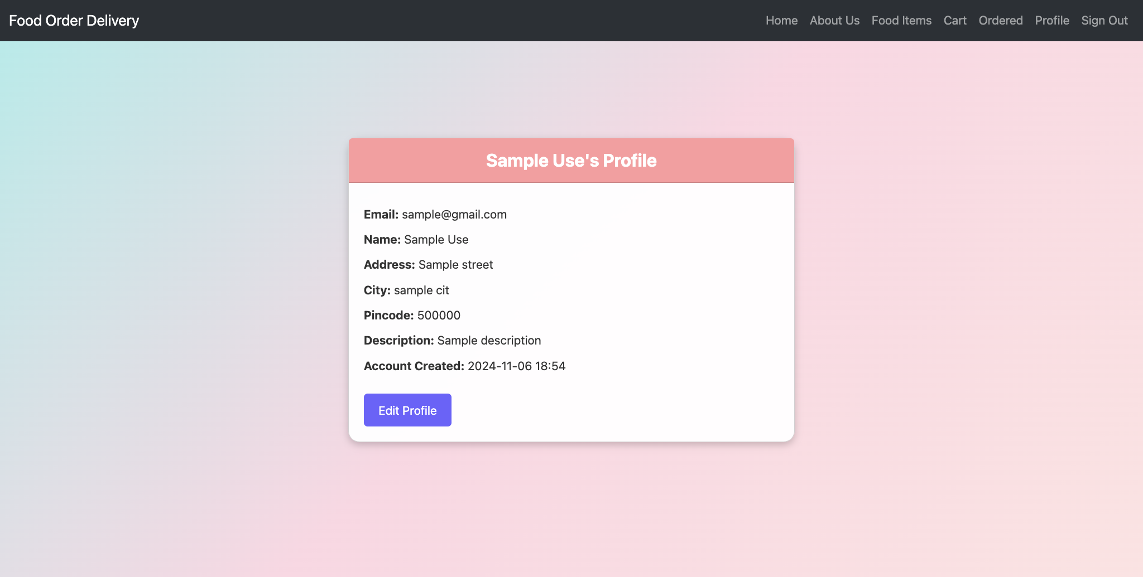
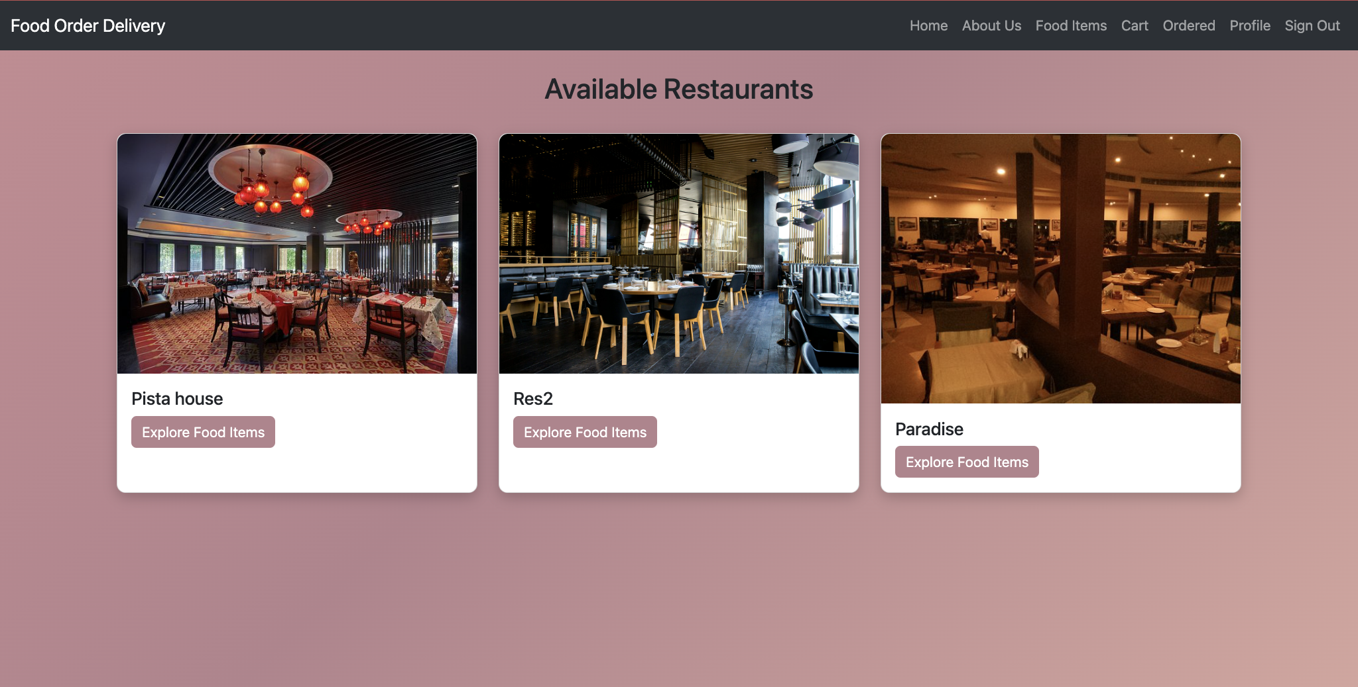
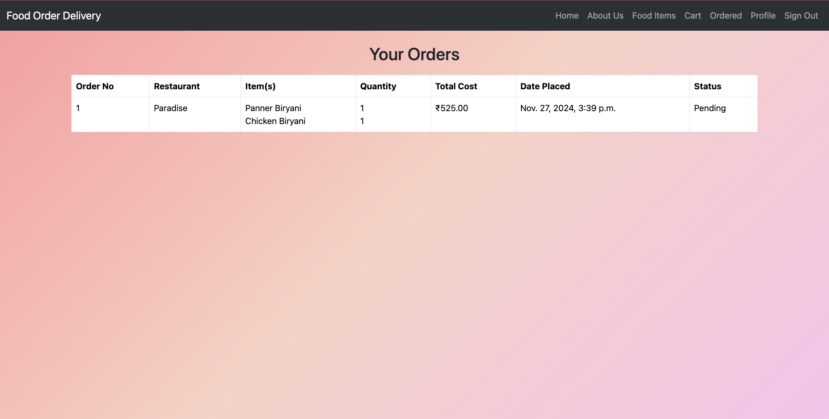

Slide 9

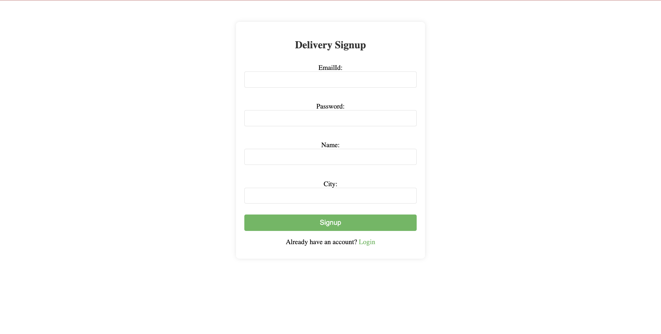
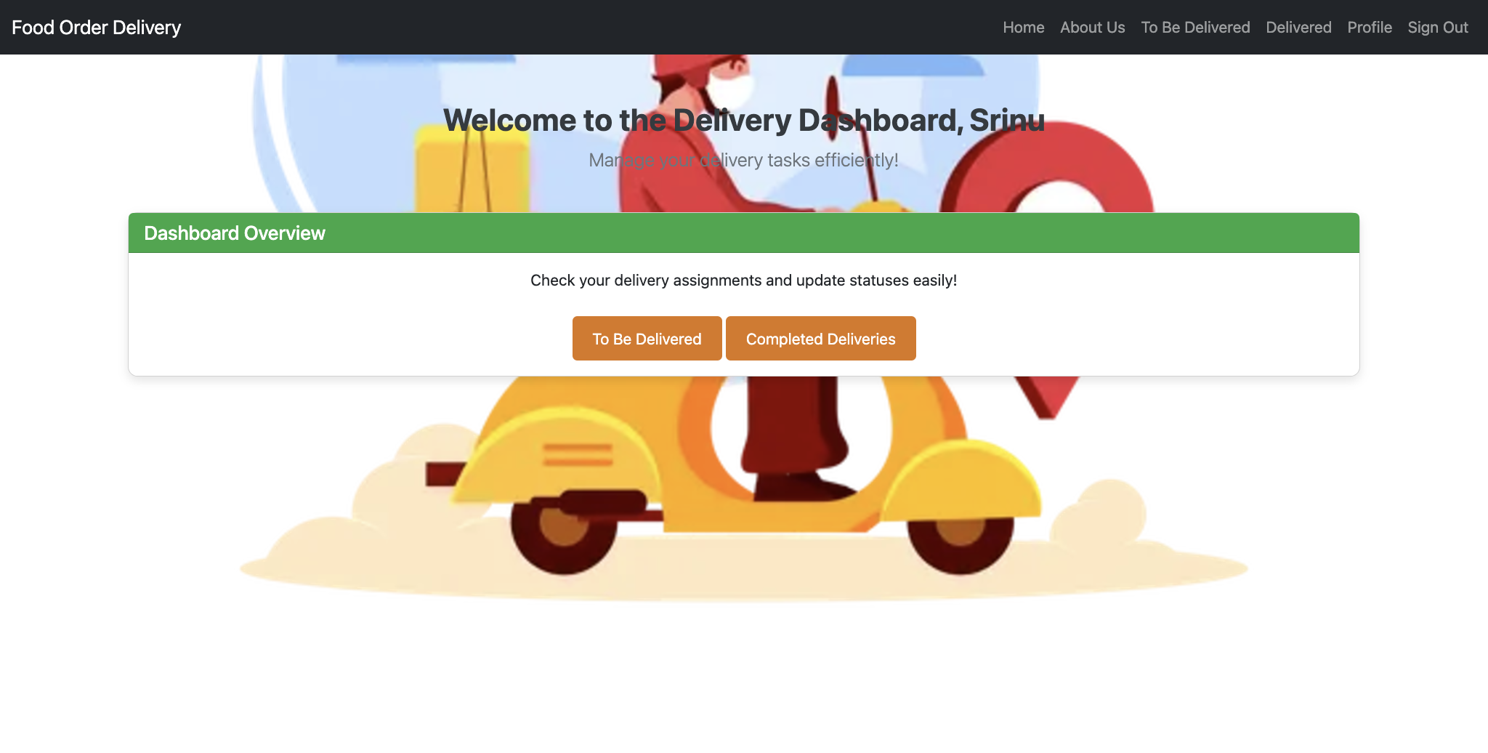
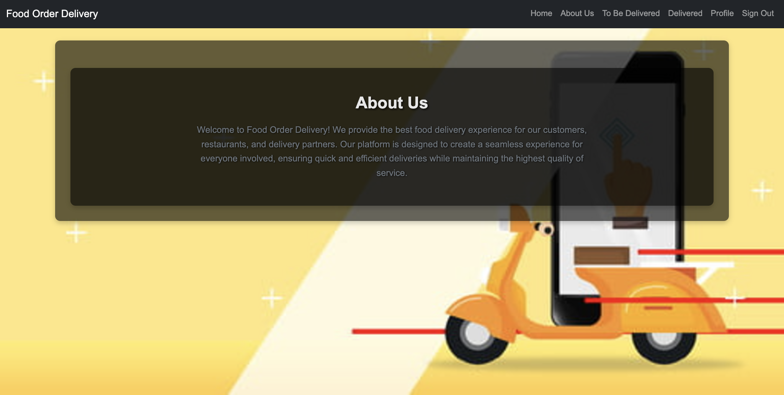
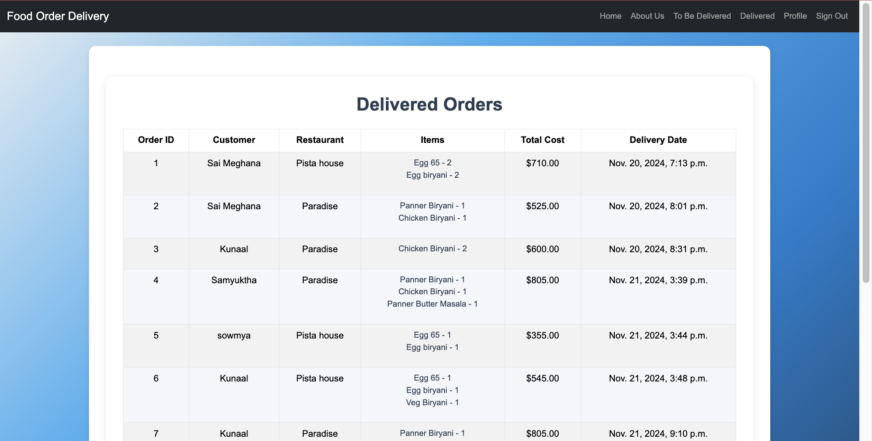
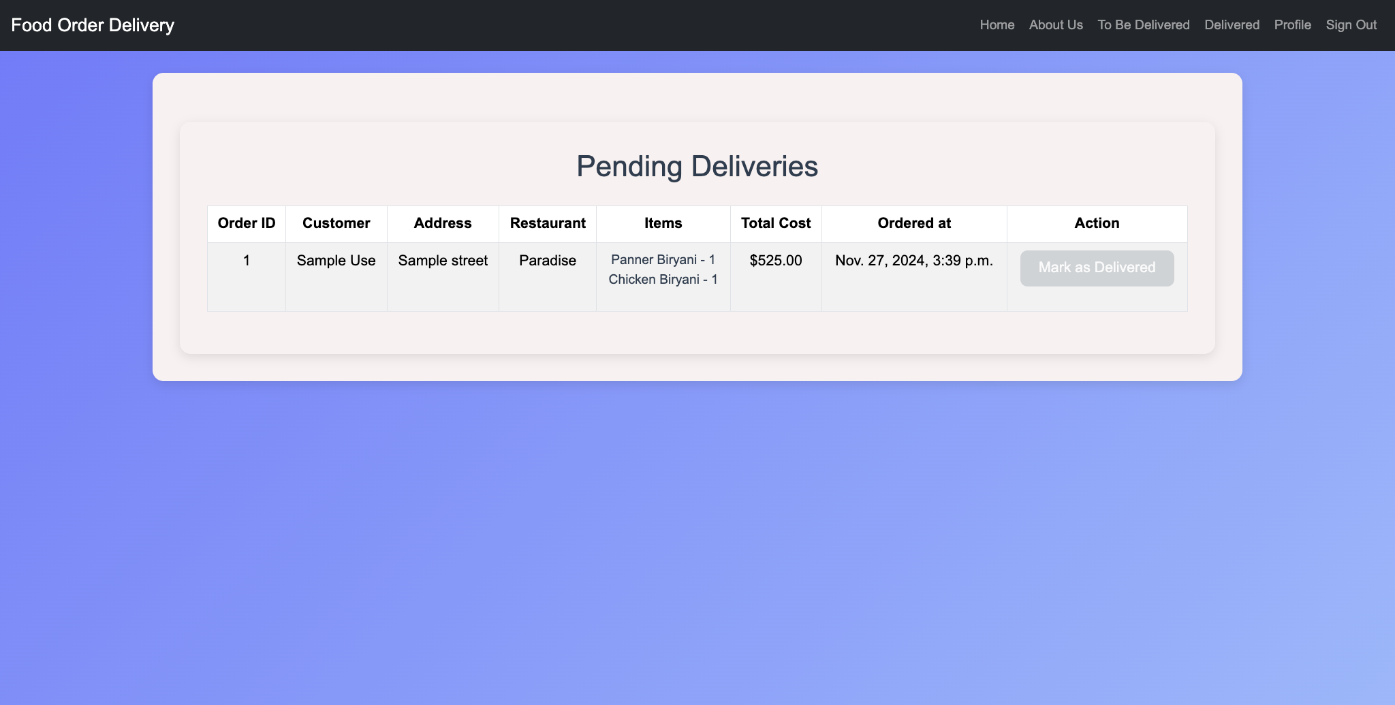
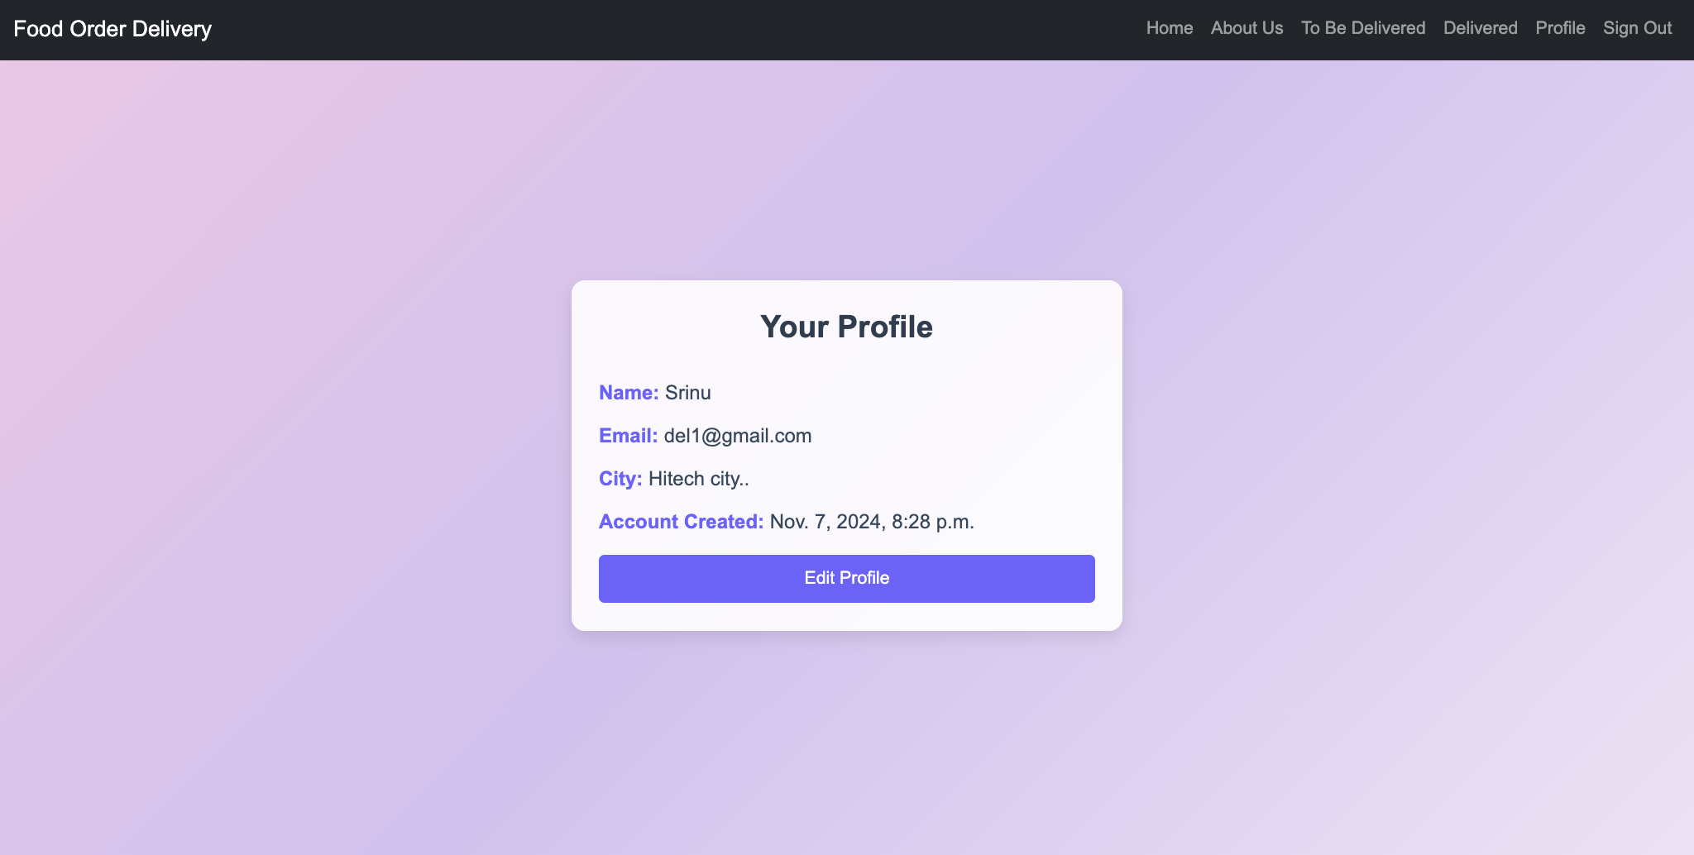
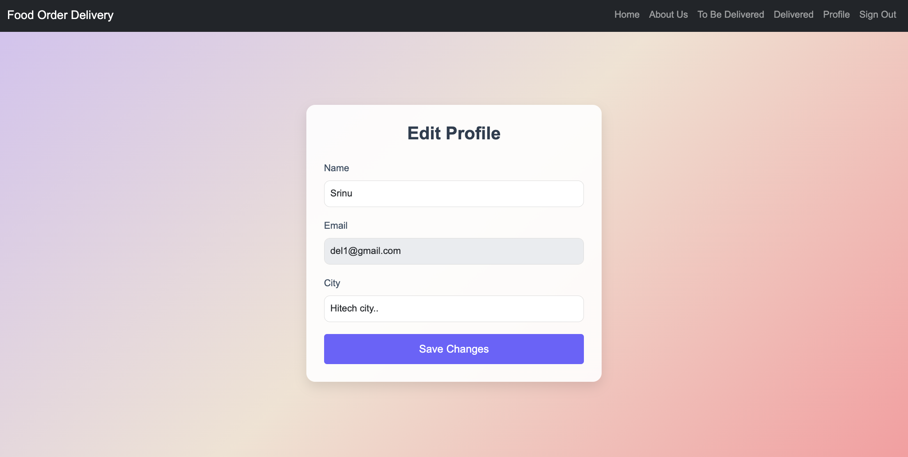
http://127.0.0.1:8000/delivery/signup/
http://127.0.0.1:8000/delivery/login/
http://127.0.0.1:8000/delivery/home/
http://127.0.0.1:8000/delivery/about/
http://127.0.0.1:8000/delivery/to_be_delivered/
http://127.0.0.1:8000/delivery/delivered/
http://127.0.0.1:8000/delivery/profile/
http://127.0.0.1:8000/delivery/edit_profile/

Slide 10

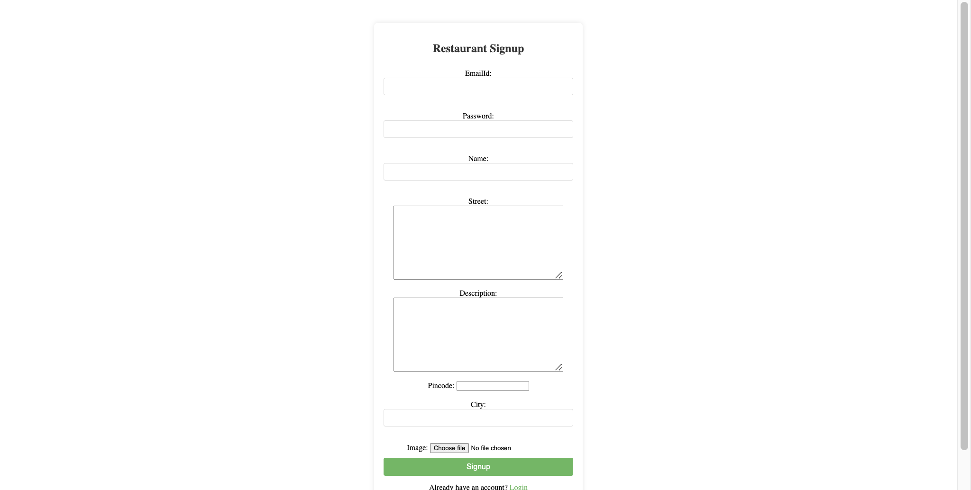
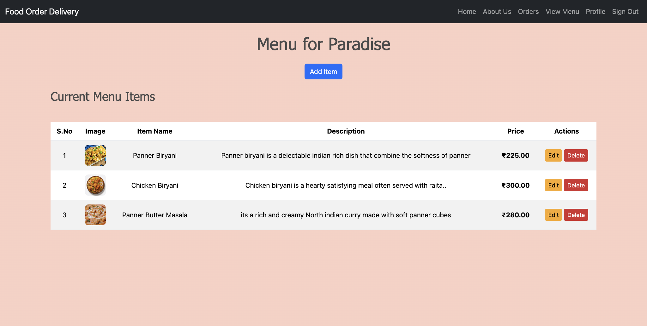
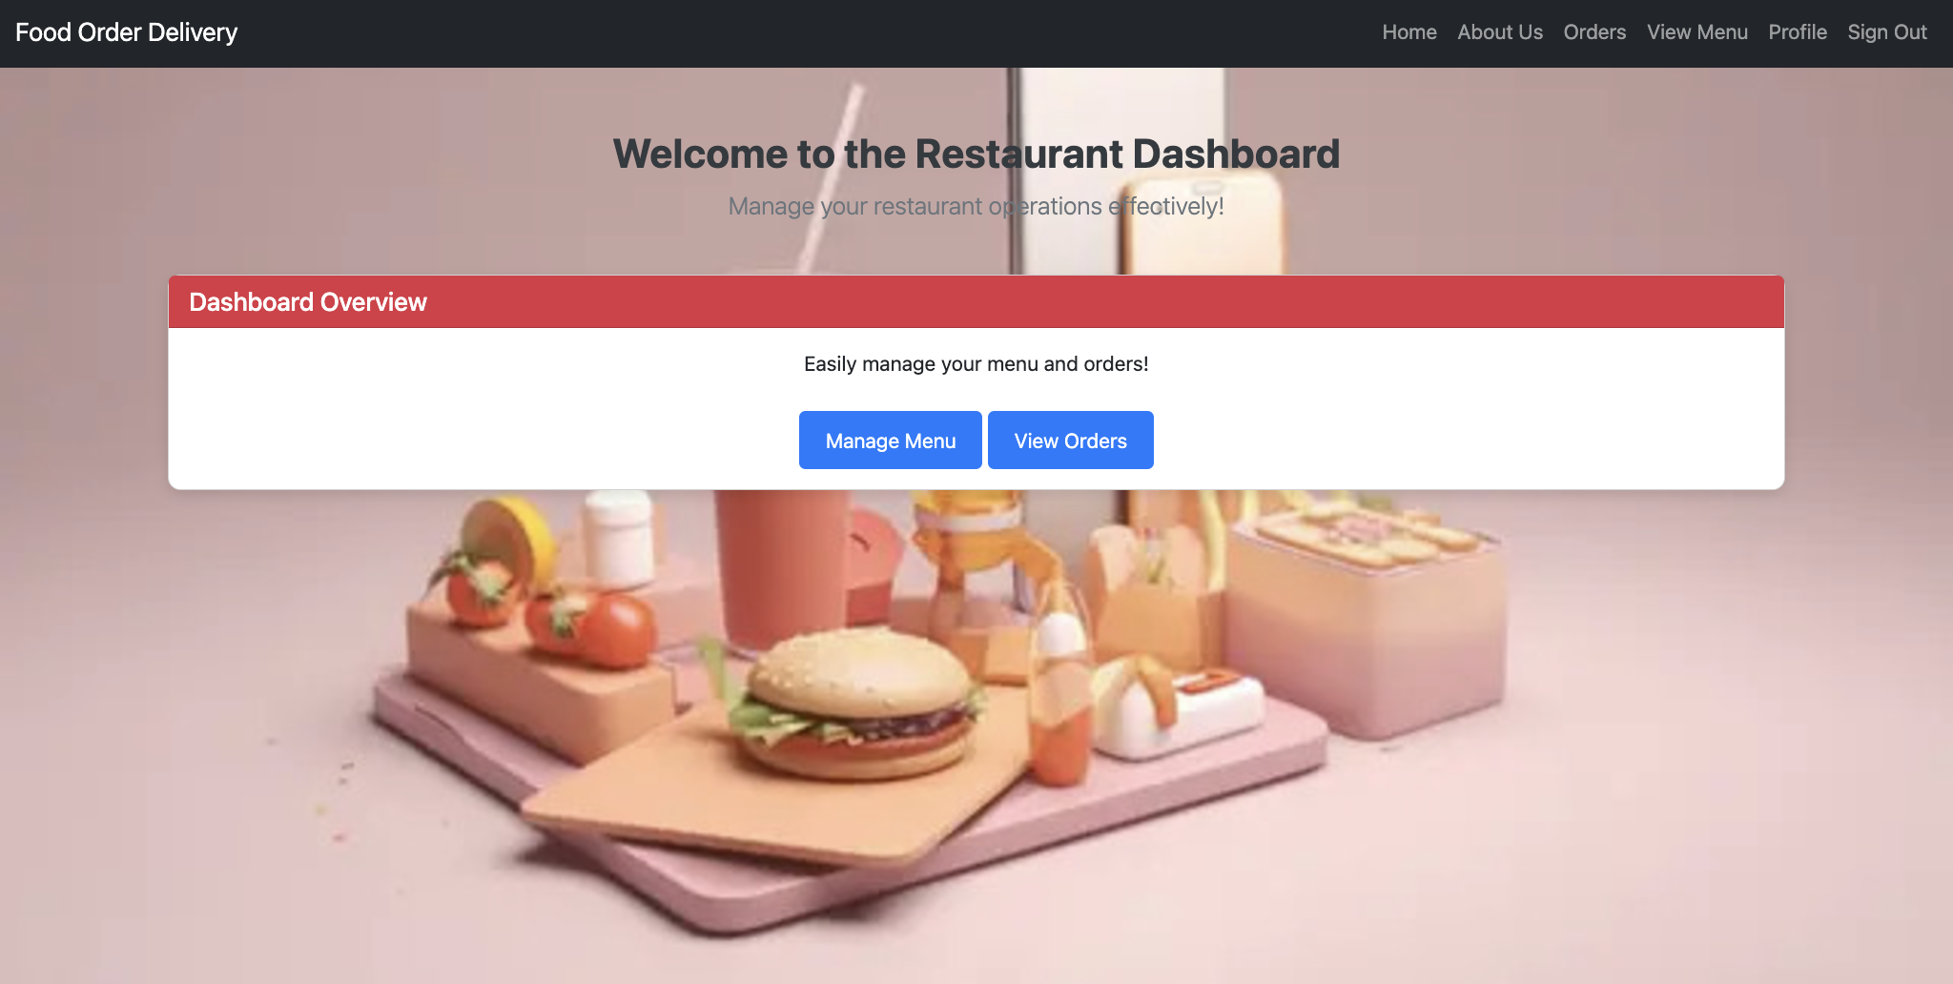
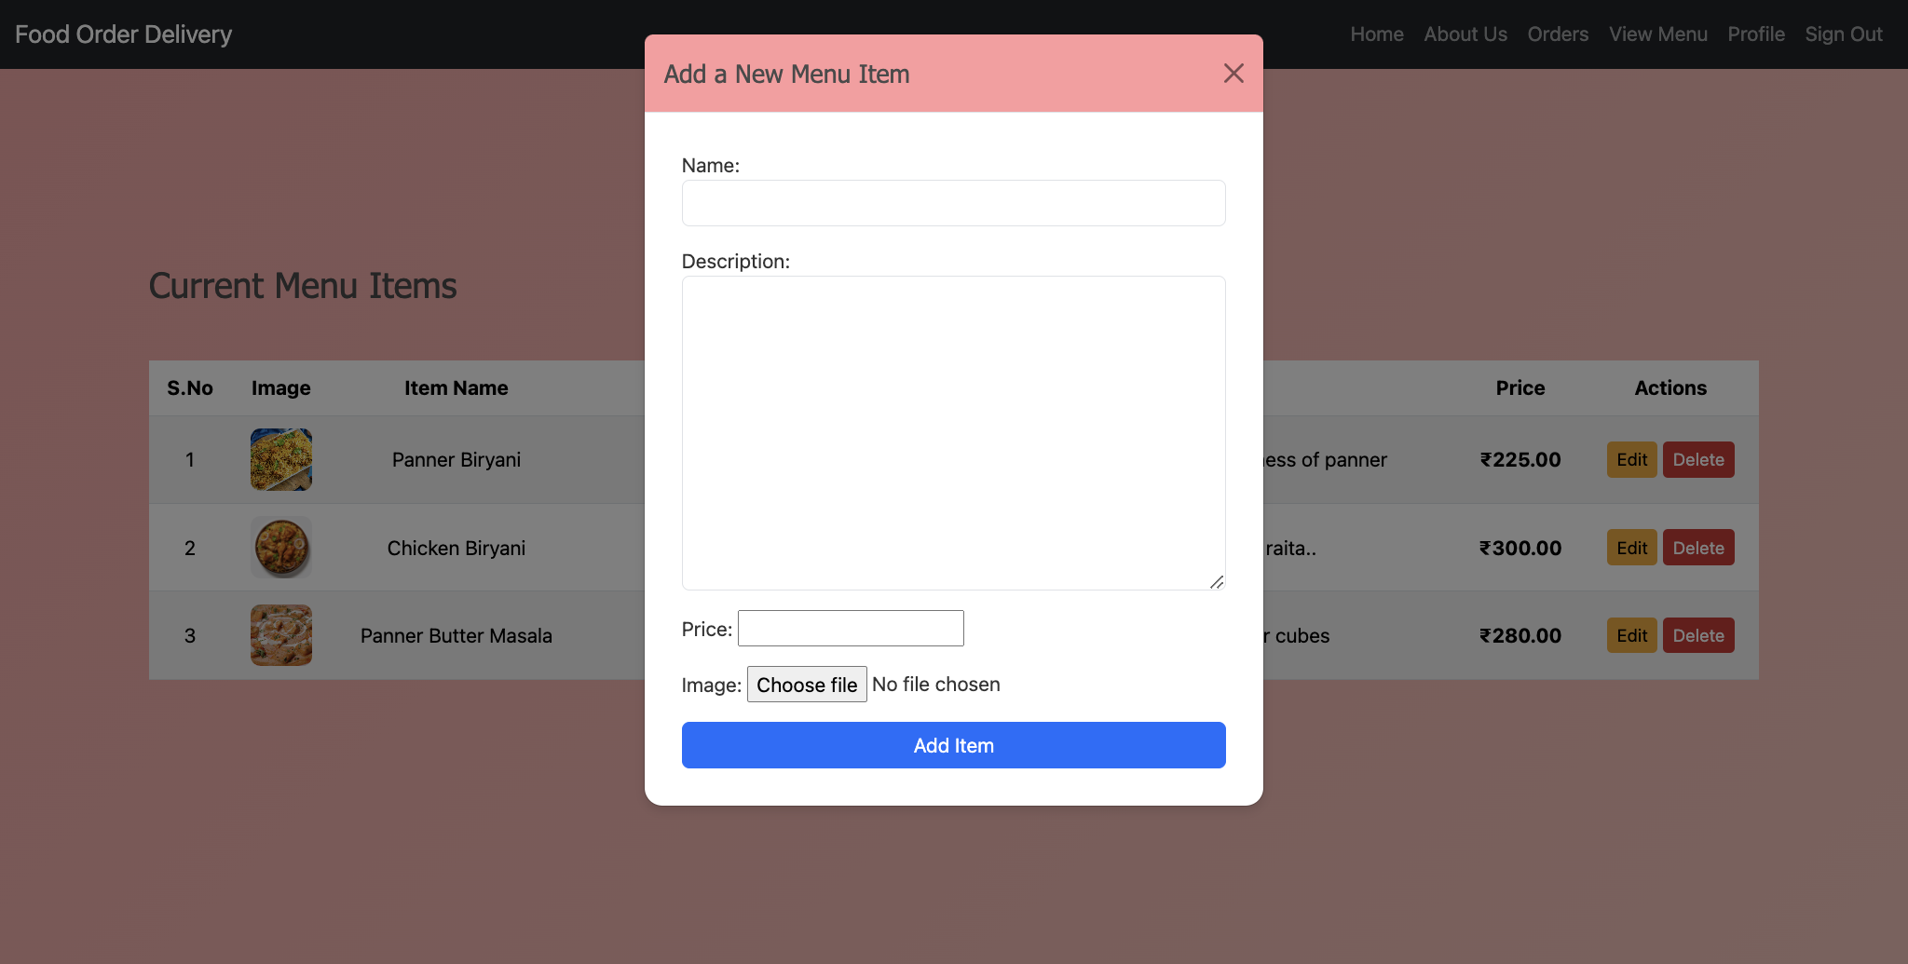
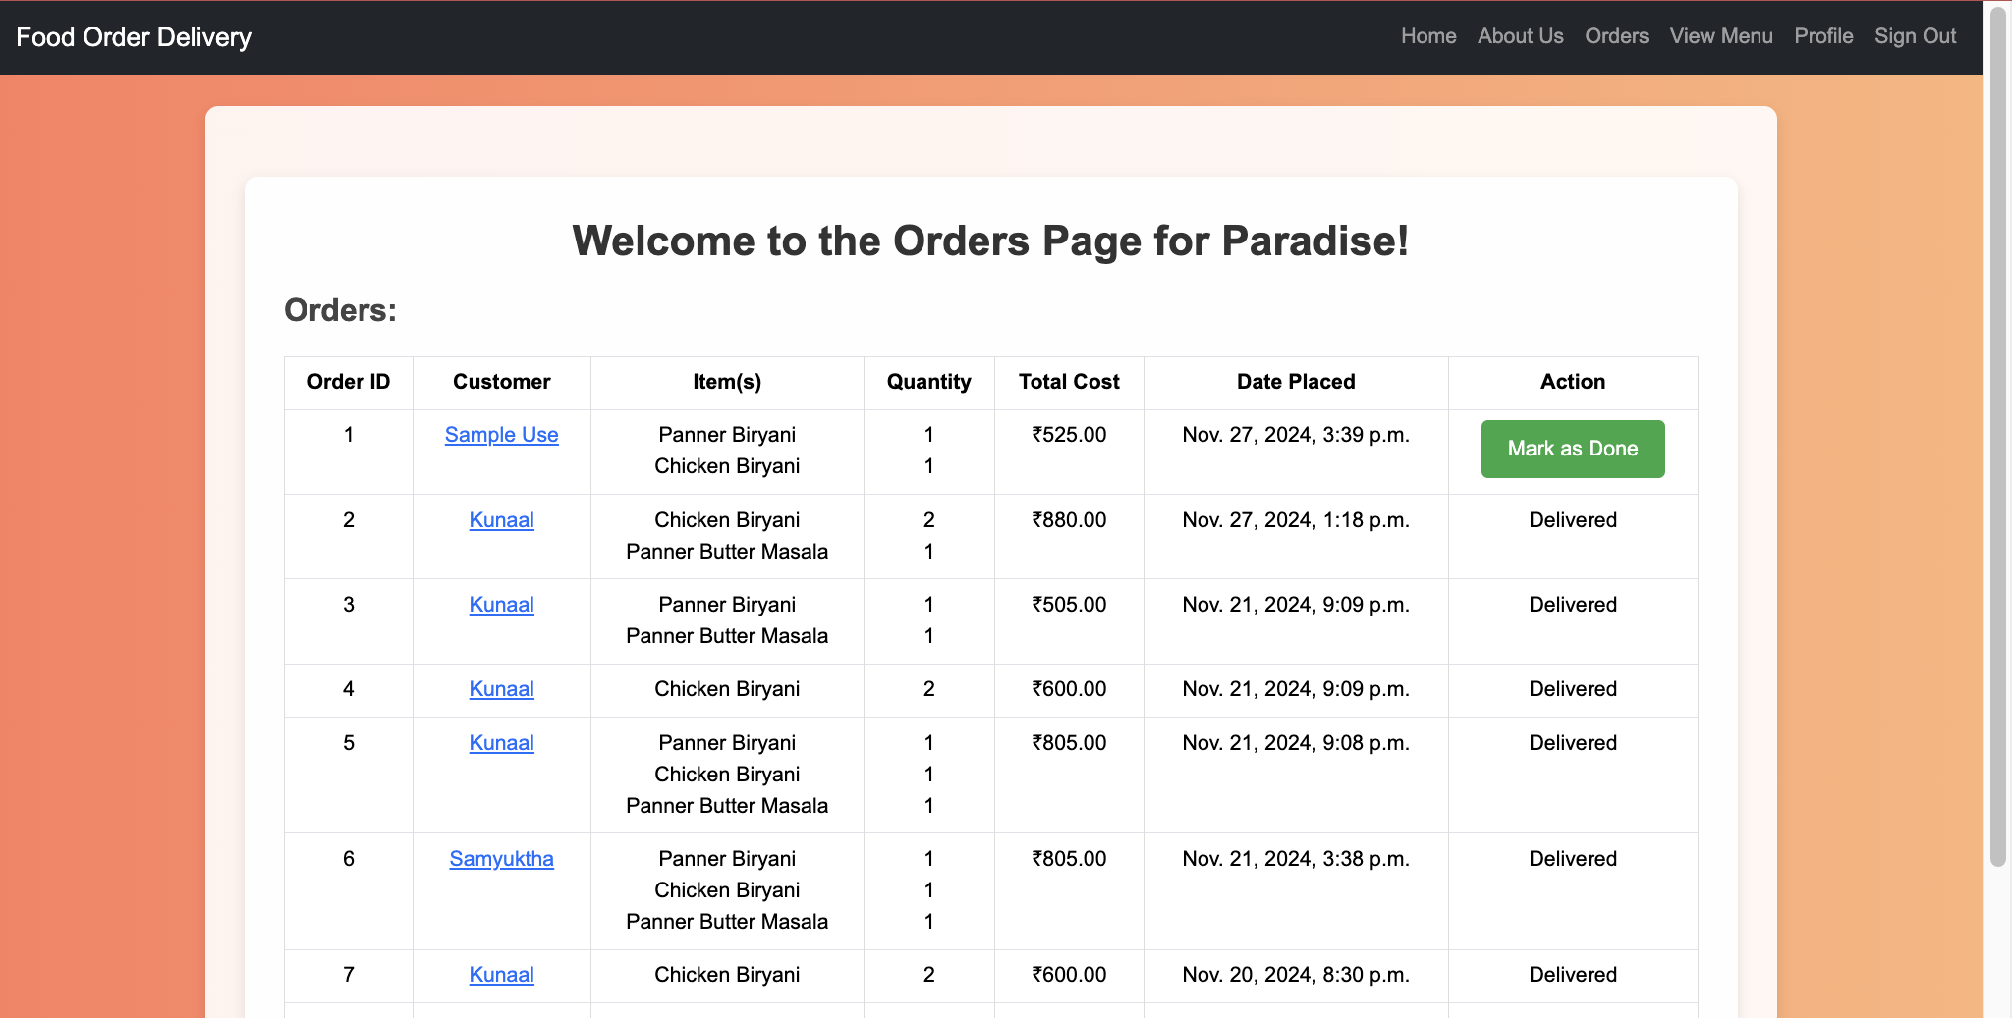
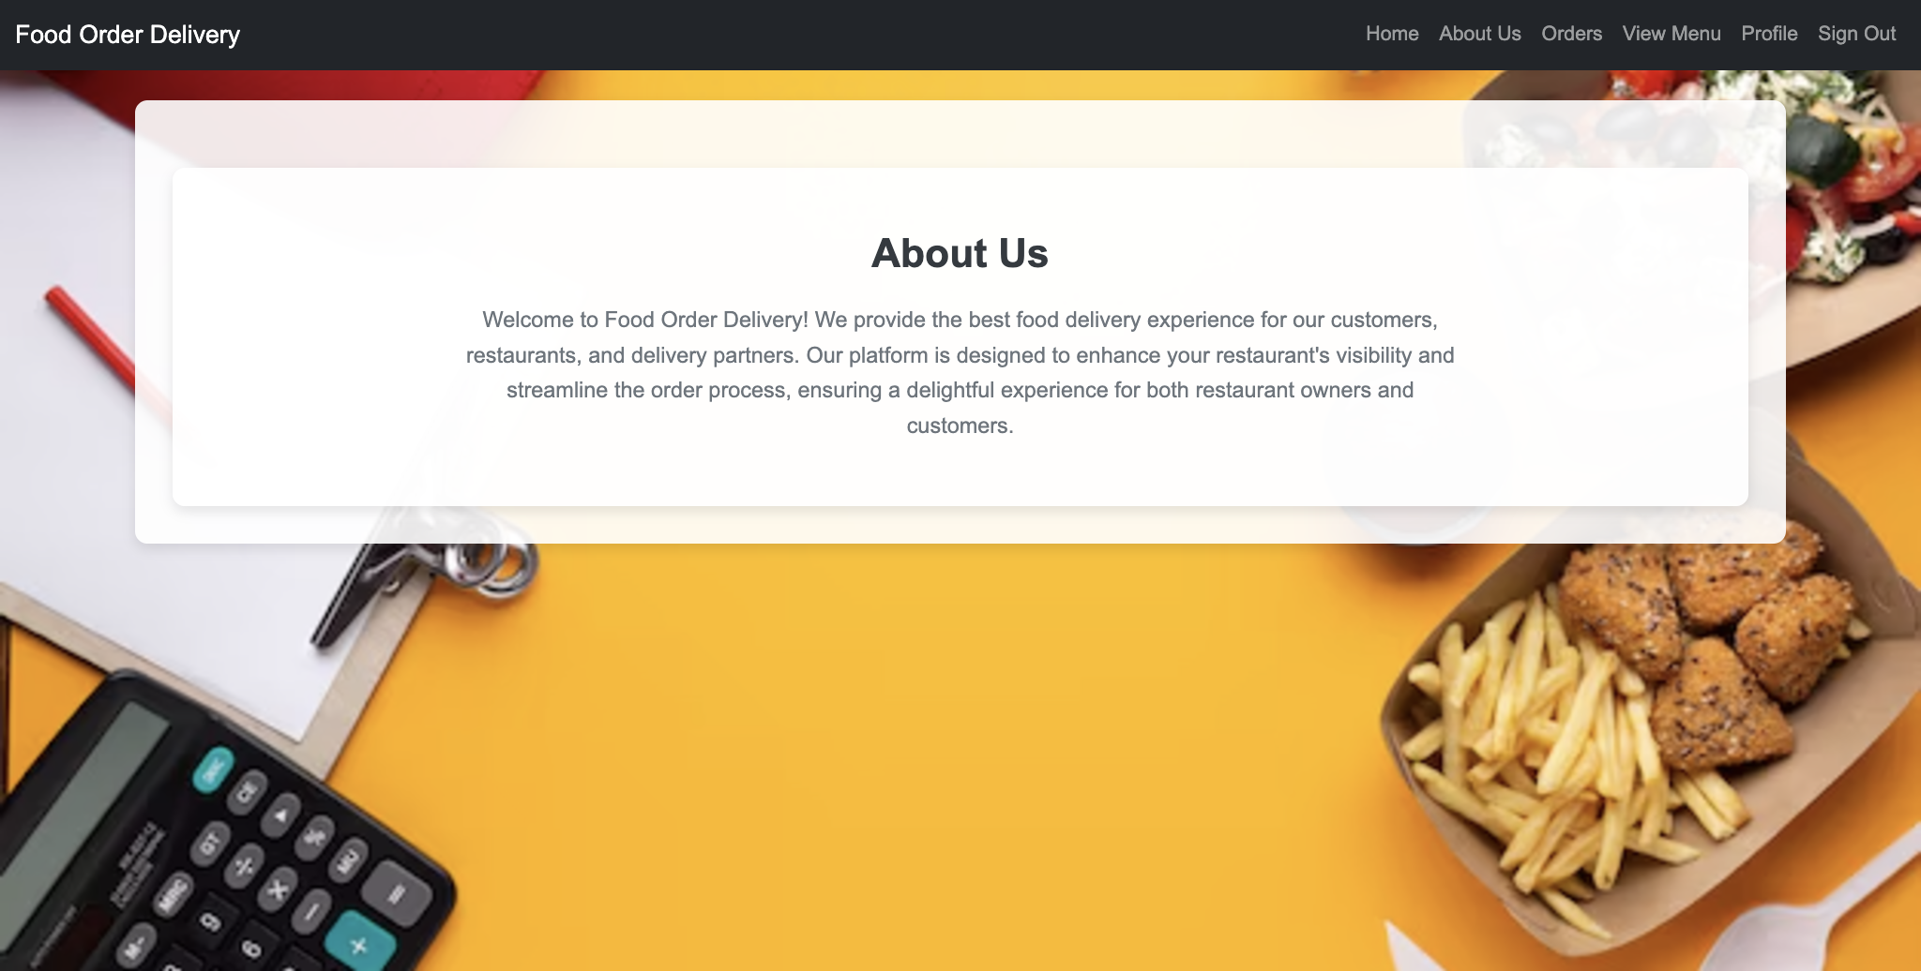
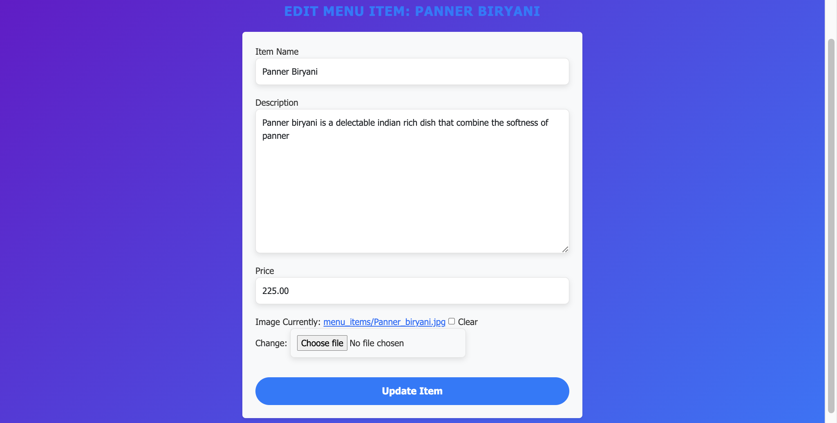
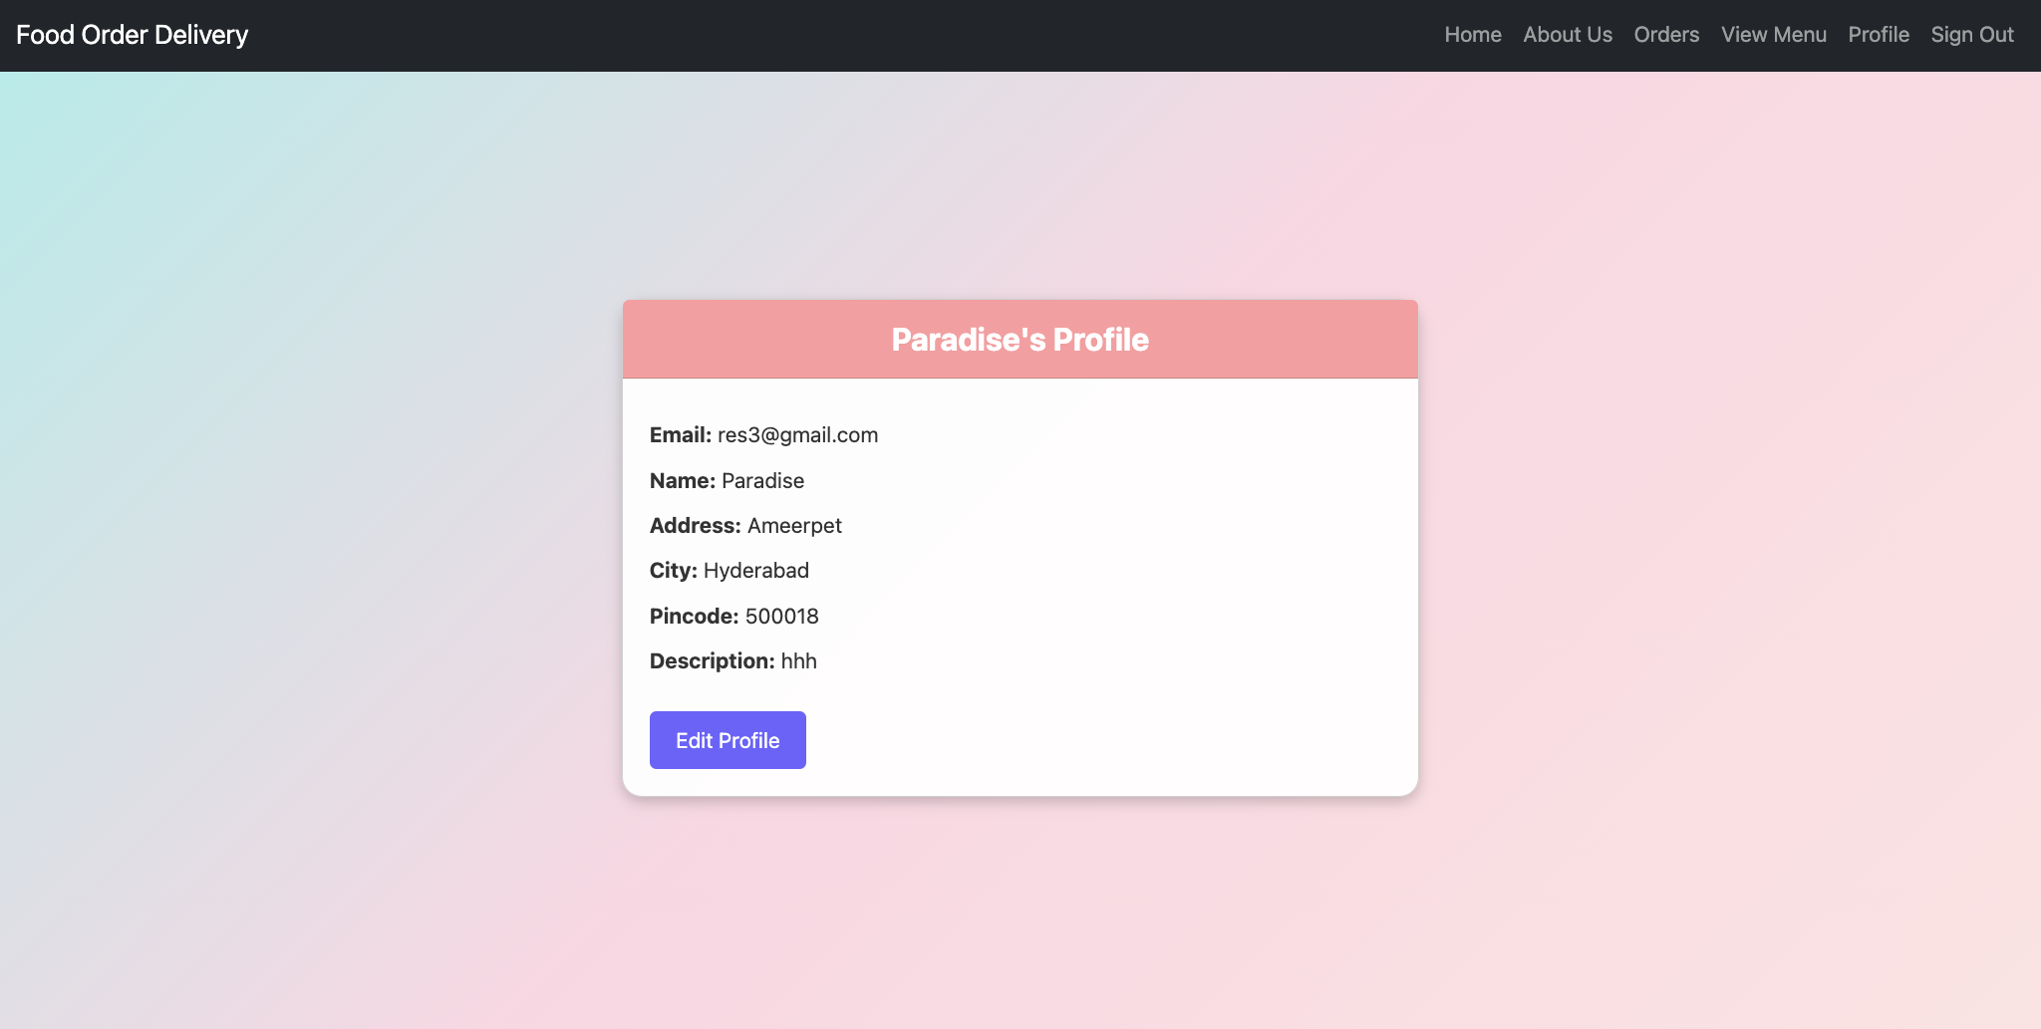
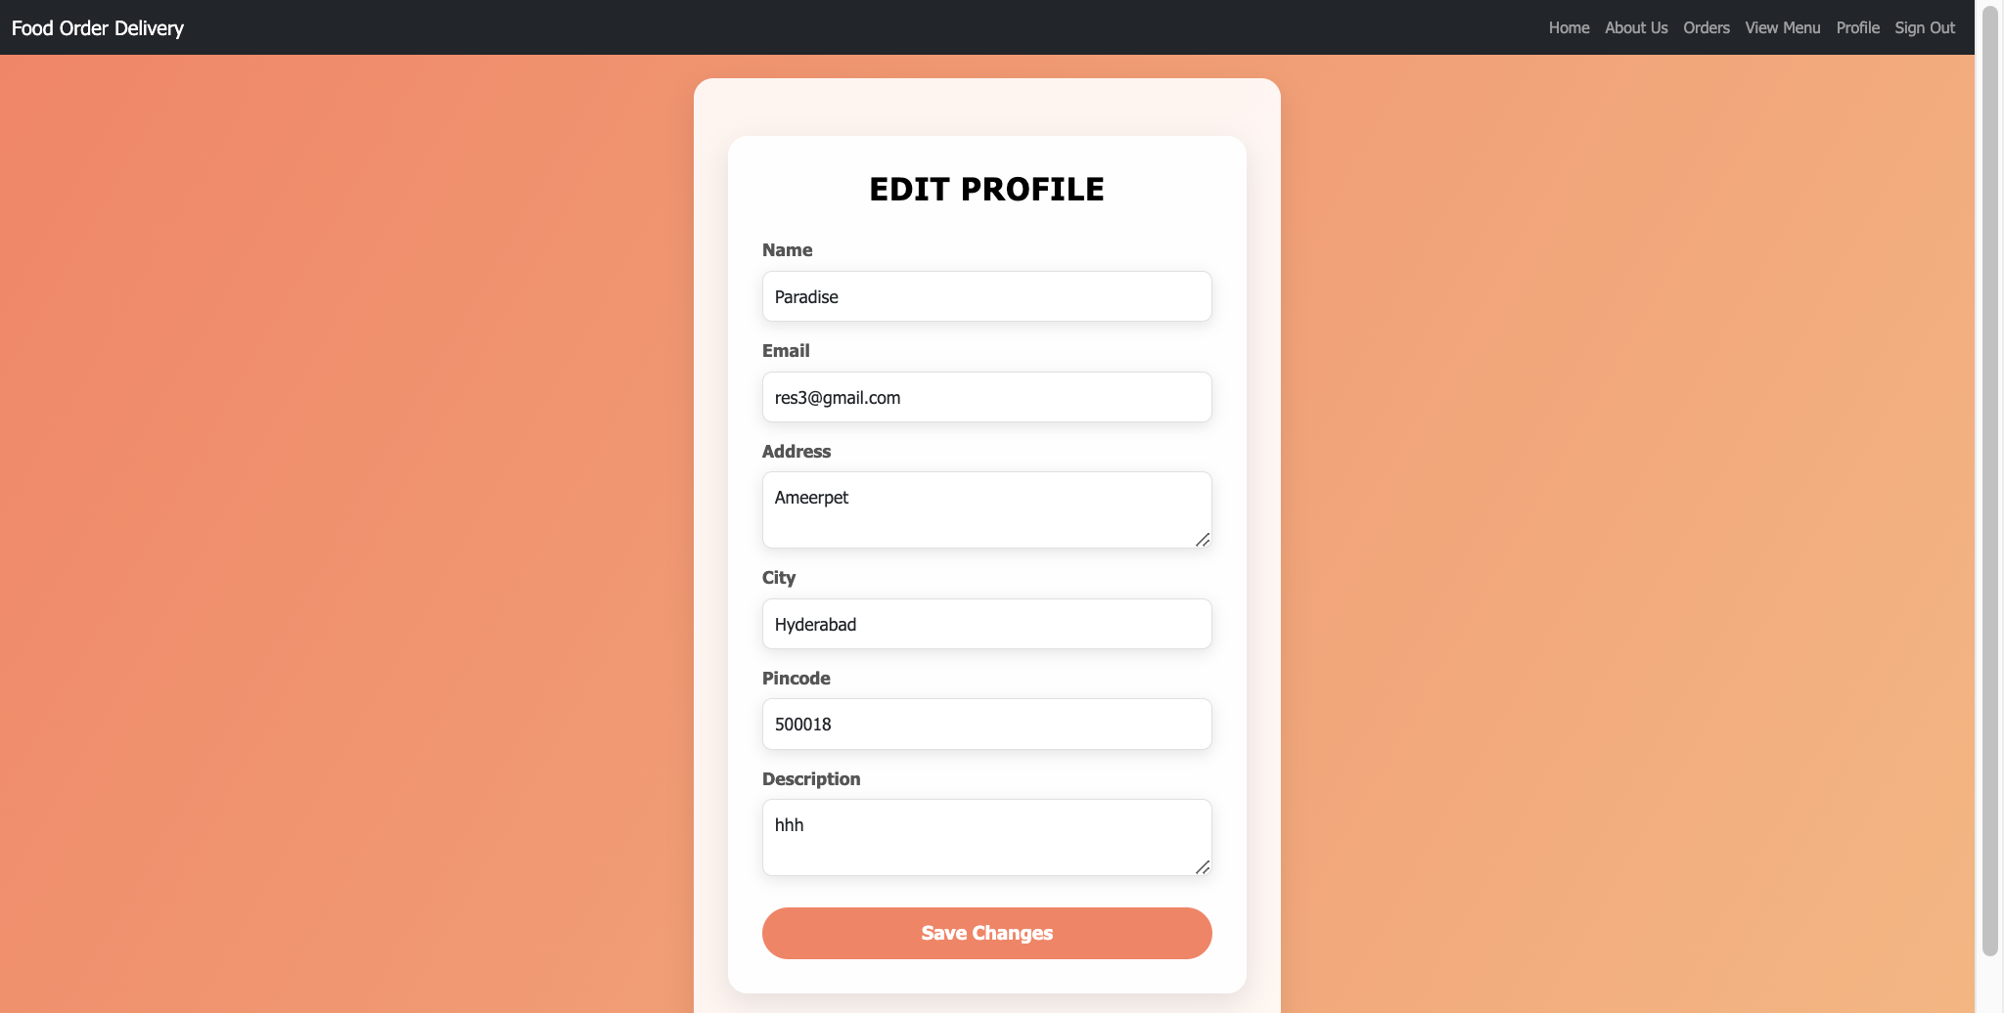
http://127.0.0.1:8000/restaurant/signup/
http://127.0.0.1:8000/restaurant/login/
http://127.0.0.1:8000/restaurant/<uuid:restaurant_id>/home/
http://127.0.0.1:8000/restaurant/<uuid:restaurant_id>/about/
http://127.0.0.1:8000/restaurant/<uuid:restaurant_id>/orders/
http://127.0.0.1:8000/restaurant/<uuid:restaurant_id>/menu/
http://127.0.0.1:8000/restaurant/menu/edit/<int:item_id>/
http://127.0.0.1:8000/restaurant/delete_item/<int:item_id>/
http://127.0.0.1:8000/restaurant/profile/
http://127.0.0.1:8000/restaurant/profile_edit/

Slide 11
Thank you

